Slide 1
Domain adaptation for classifying disaster-related Twitter data
Department of Computer Science
College of Engineering
Presenter: Oleksandra Sopova
Major Professor: Doina Caragea
GRAD Forum
March 30, 2017

Slide 2
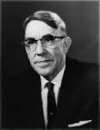
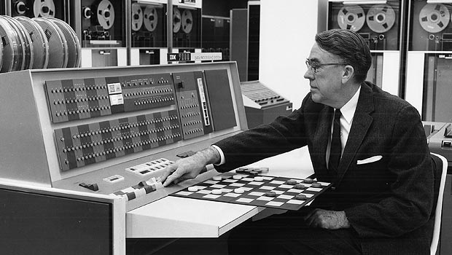
What is Machine Learning?
Arthur Samuel
(1901-1990)
– a pioneer of artificial intelligence research
Arthur Samuel’s Checkers program is considered a milestone for artificial intelligence, and offered the public in the early 1960s an example of the capabilities of an electronic computer.

Slide 3

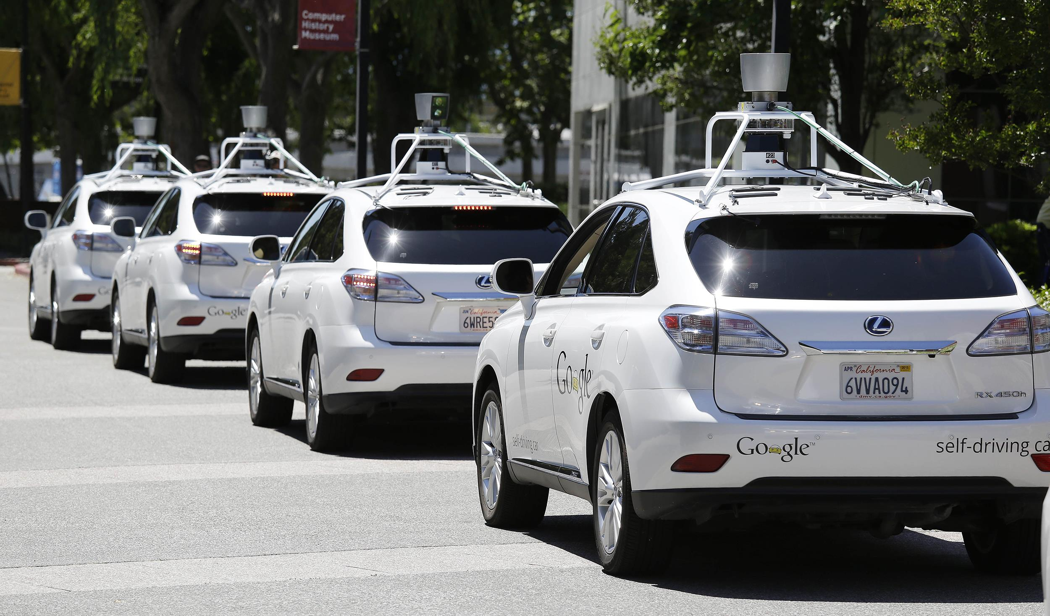

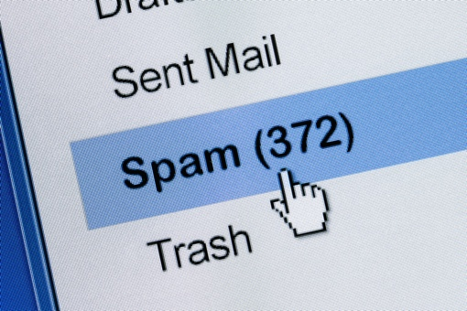


What is Machine Learning?
Examples of machine learning tasks may include:
Recommender systems
Self-driving cars
Image search
[Link]
[Link]
Machine Translation
Spam Filtering
Text Recognition
[Link]
[Link]
[Link]

Slide 4
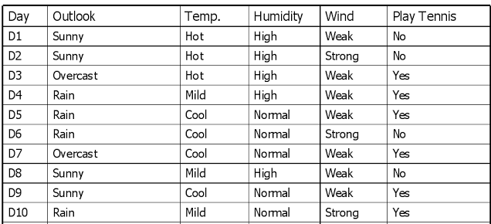

Terminology
Instances (examples, observations)
[Link]
Could you predict the values of “Plat Tennis”?
?
?
?
[Link]

Slide 5
Terminology
Label (class)
Instances (examples, observations)
[Link]
Could you predict the values of “Plat Tennis”?
?
?
?
[Link]

Slide 6
Terminology
Features
Label (class)
Instances (examples, observations)
[Link]
Could you predict the values of “Plat Tennis”?
?
?
?
[Link]

Slide 7
Terminology
Supervised Machine Learning
– learning from labeled data
Unsupervised Machine Learning
– learning from unlabeled data

Slide 8
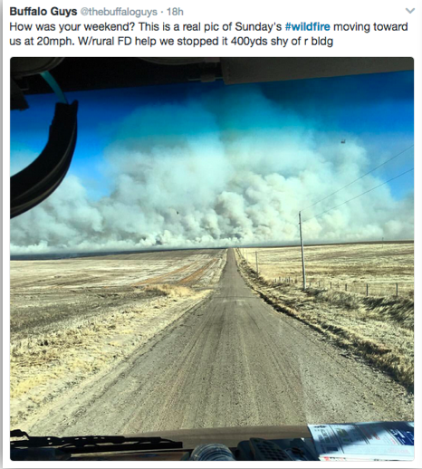
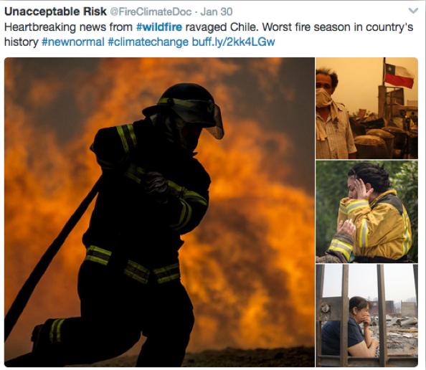
Twitter for Disaster Management

Slide 9

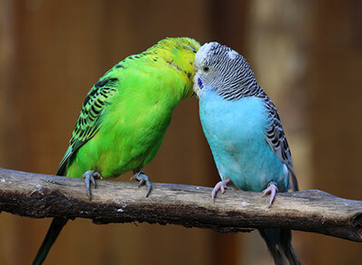
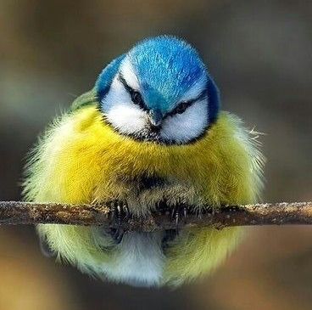
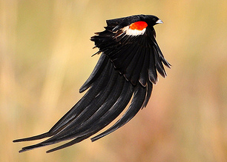
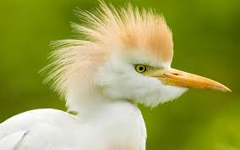
Motivation for Machine Learning
Some tasks are difficult to define algorithmically
Example: is there a bird in a given picture?

Slide 10



Motivation for Machine Learning
Human language is ambiguous
Could you come up with a general rule to tell which tweets are about natural disasters?

Slide 11
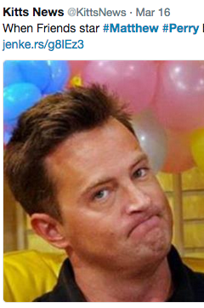
Motivation for Machine Learning
Human language is ambiguous
Using hashtags?
– not too reliable:

Slide 12
Supervised Learning Model Workflow
Step 1: Collecting, cleaning, preprocessing of data (training data)
Feature Extraction
Preprocessed Data, Labels
Raw Data, Labels

Slide 13
Supervised Learning Model Workflow
Step 2: Training a machine learning model
Preprocessed Data, Labels
Machine Learning Algorithm
Feed the data
Trained Machine Learning Model

Slide 14
Supervised Learning Model Workflow
Step 3.1: Preprocessing of unseen data (testing data)
Feature Extraction
Preprocessed Unseen Data
Unseen Raw Data

Slide 15
Supervised Learning Model Workflow
Step 3.2 : Predicting output on unseen data (testing data)
Trained Machine Learning Model
Preprocessed Unseen Data
Feed the data
Output
(i.e. predicted labels)

Slide 16
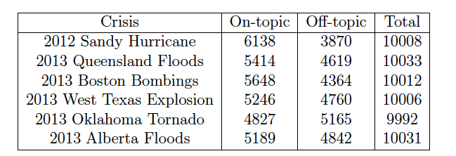
Data Description
Original dataset:
60,000 tweets posted during 6 crisis events in 2012 and 2013

Slide 17
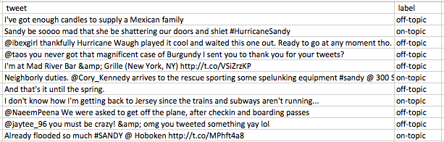
Data Description
Original tweets:

Slide 18
Data Preprocessing
Original tweets:
“@ibexgirl thankfully Hurricane Waugh played it cool”
“I'm at Mad River Bar &amp; Grille (New York, NY) http://t.co/VSzKP”
Preprocessed tweets:
“USERNAME thankfully Hurricane Waugh played it cool”
“I'm at Mad River Bar & Grille (New York, NY) URL”

Slide 19
Supervised Machine Learning

Slide 20
Domain Adaptation Terminology

Slide 21
Motivation for Domain Adaptation

Slide 22
Problem Definition

Slide 23
Single-source Domain Adaptation Approach

Slide 24
Correlation Alignment Algorithm

Slide 25
Feature Selection

Slide 26
Naive Bayes Classifier

Slide 27
Experiments

Slide 28
Results

Slide 29
Terminology
[Link]

